Slide 1


Slide 2

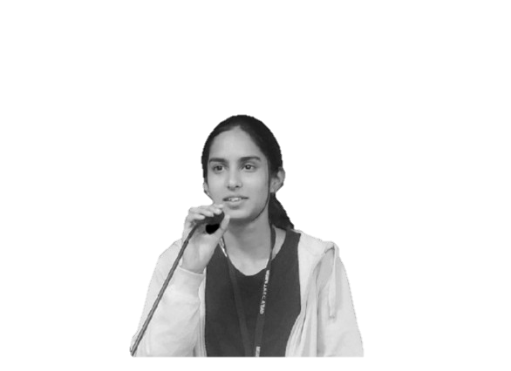


Team Ironman
Prathmesh Shekade
Rushikesh Gore
Pratik Modi
Ekta Joge
IT 3rd year
IT 2nd year
IT 2nd year
IT 2nd year

Slide 3

Quality Education
Problem Statement
In many parts of the world, students face challenges like limited resources, unequal opportunities, and outdated teaching methods, preventing them from receiving the quality education they deserve, a crucial step towards achieving a brighter future.

Slide 4
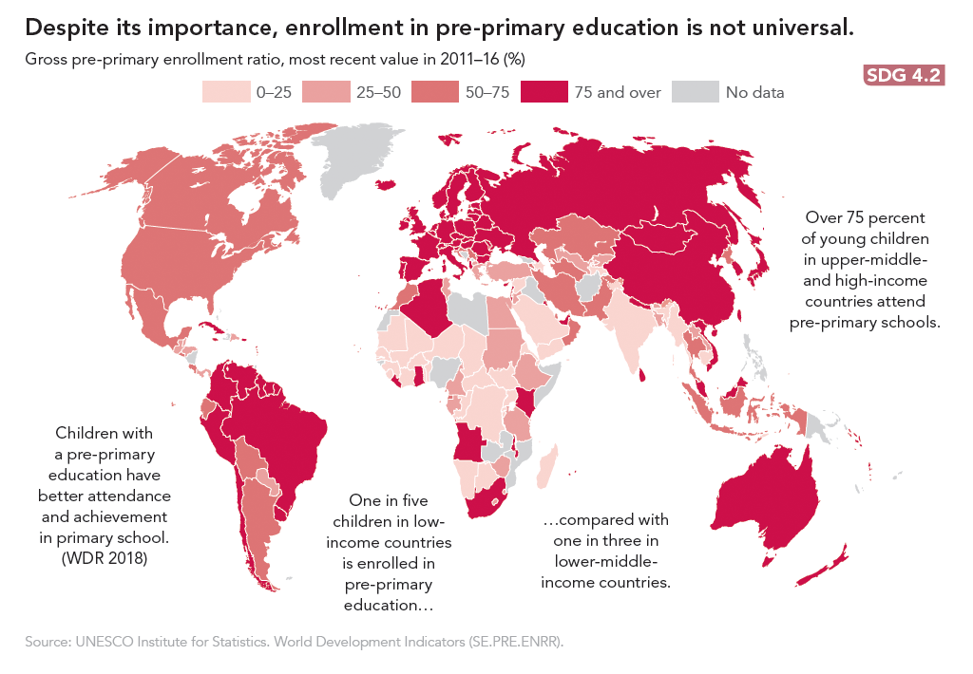
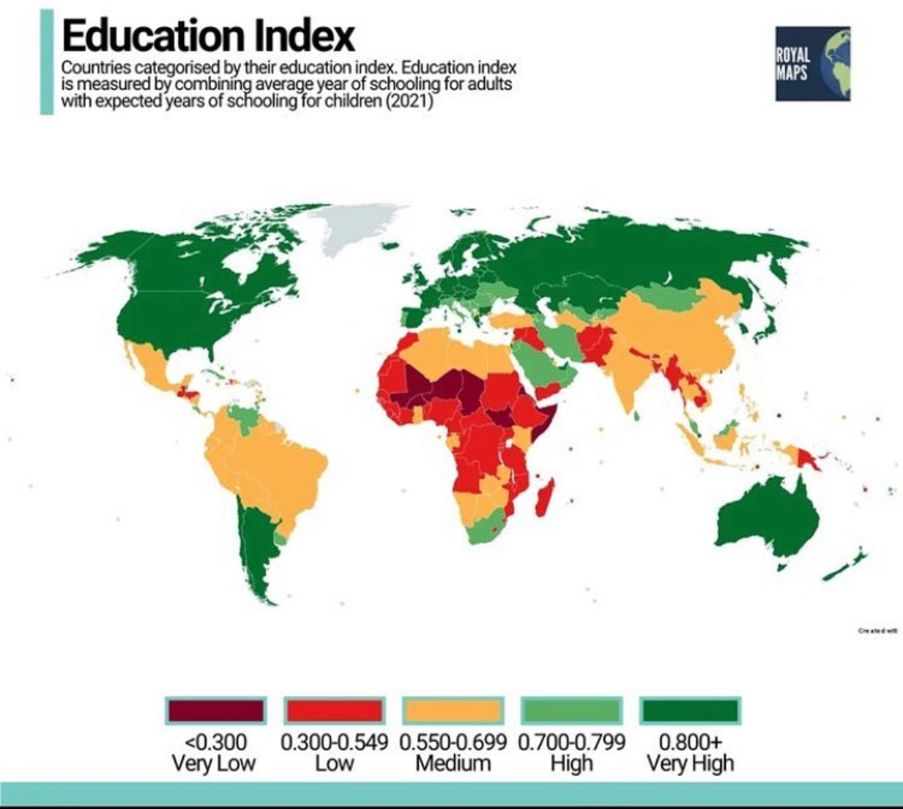

Slide 5

GOAL(S) AND TARGET(S)
By 2030, ensure that all girls and boys complete free, equitable and quality primary and secondary education leading to relevant and Goal-4 effective learning outcomes
By 2030, ensure that all girls and boys have access to quality early childhood development, care and preprimary education so that they are ready for primary education
By 2030, ensure equal access for all women and men to affordable and quality technical, vocational and tertiary education, including university
By 2030, substantially increase the number of youth and adults who have relevant skills, including technical and vocational skills, for employment, decent jobs and entrepreneurship
Build and upgrade education facilities that are child, disability and gender sensitive and provide safe, nonviolent, inclusive and effective learning environments for all

Slide 6
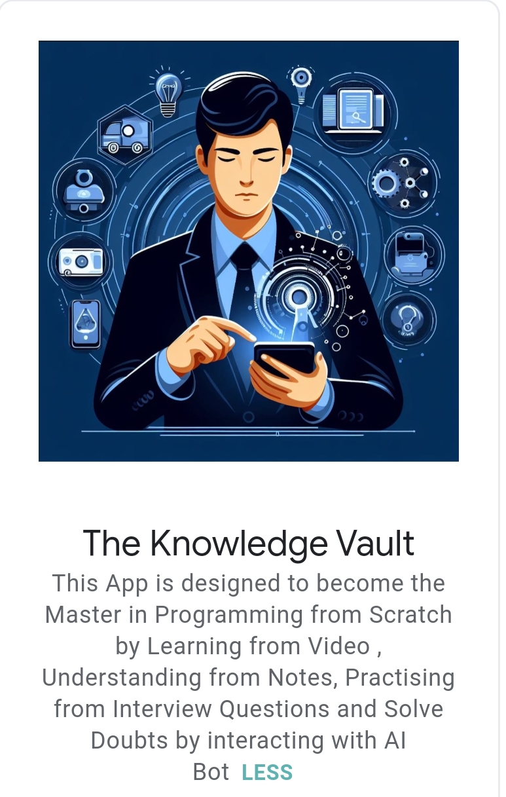
Our Inspiration
Our Solution
Confidence Seekers
Aspiring Coders
Job seekers in Tech
Concept Reviewers
Unified Platform

Slide 7

Justification for Our Solution
pocket-sized personal tutor for BTech studies.
Engaging videos, AI assistance, and clear notes in one place.
Shortcut to acing exams and excelling in job interviews.
Easy and fun learning experience with The Knowledge Vault.

Slide 8
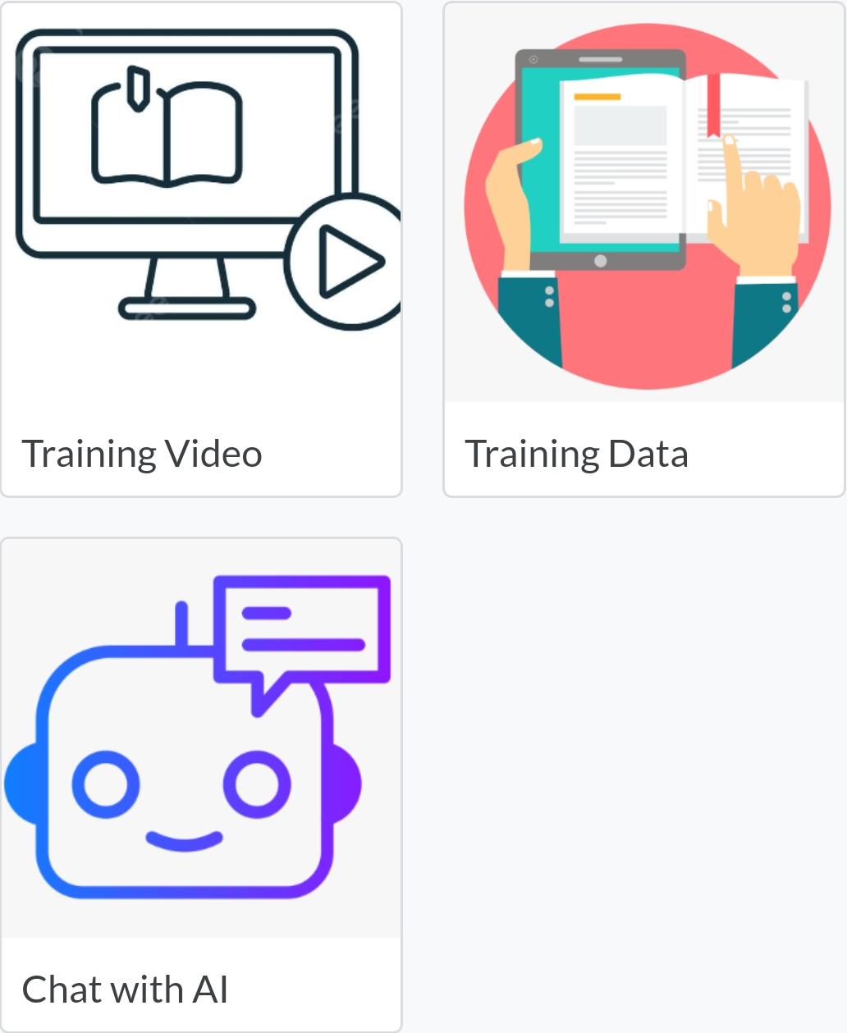
Architecture of Our Solution & Choice of Products/Platforms
Organised videos from basic to advance
Various notes and Interview Questions for quick revisions
Integrated AI Tools: Chat Gpt
Google Bard
Black box AI
User will not require to sign in any of the AI tools Interfaces

Slide 9
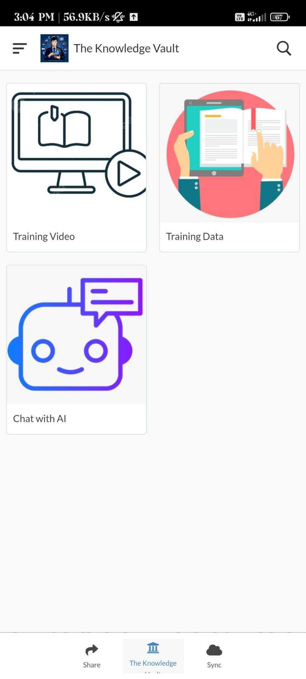
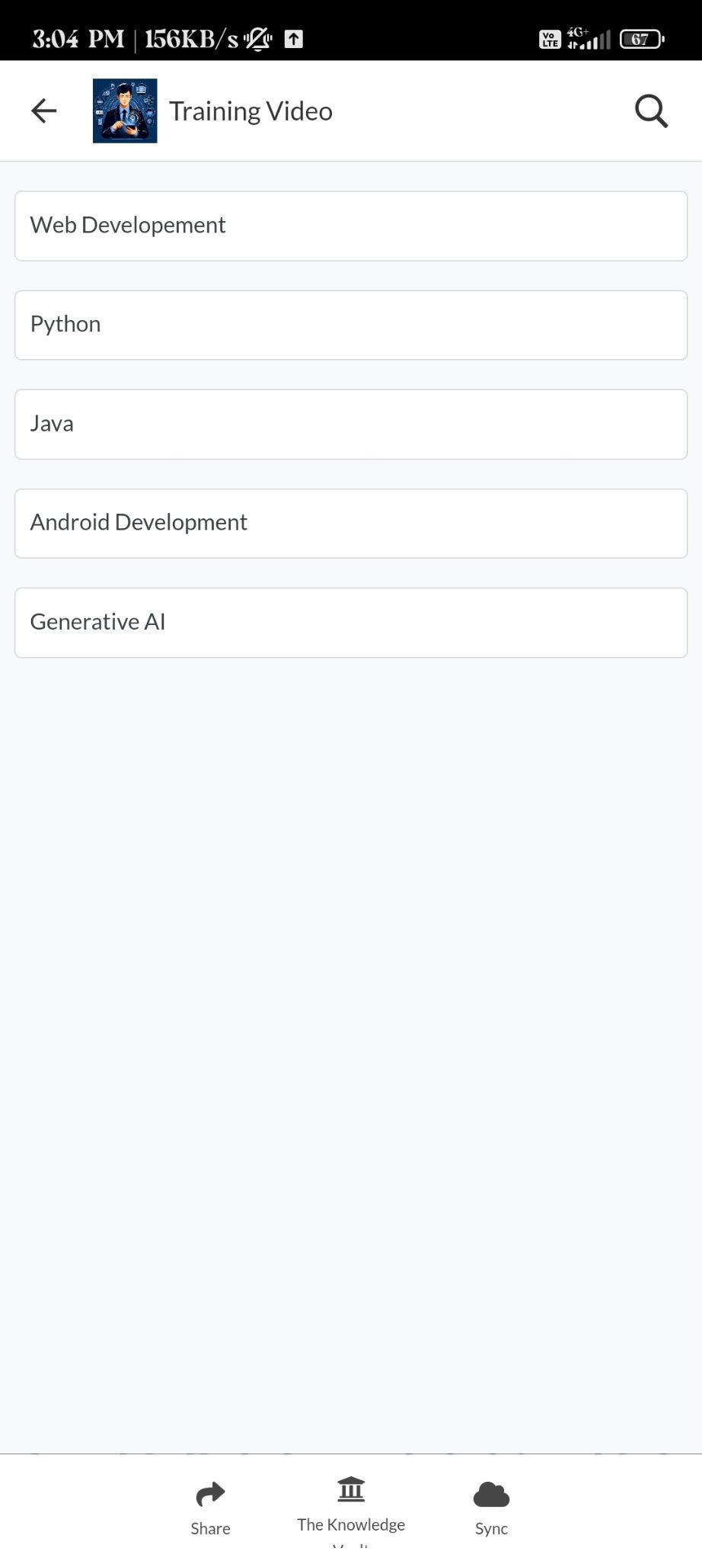


In training video there are playlist of videos which helps in clearing doubts and being master in particular programming domain.

Slide 10
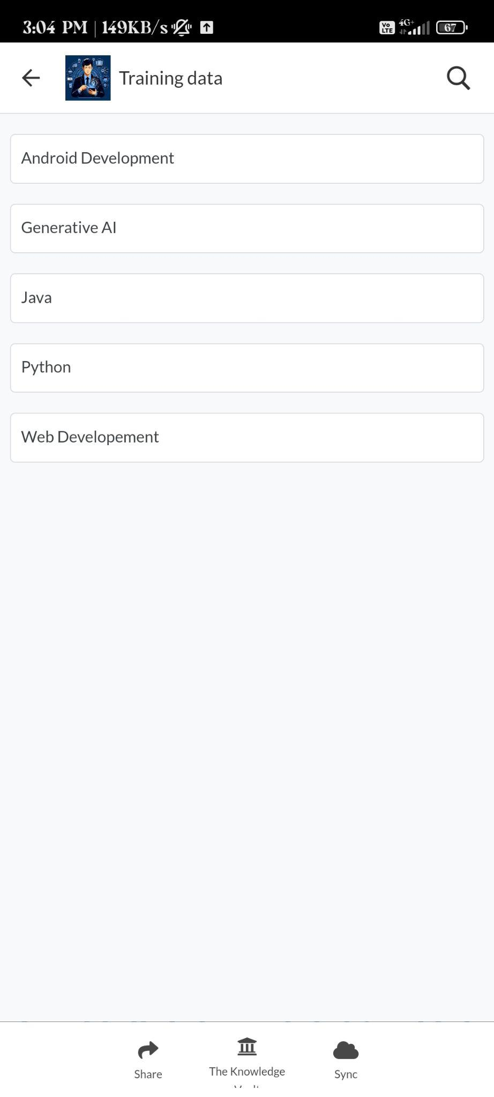
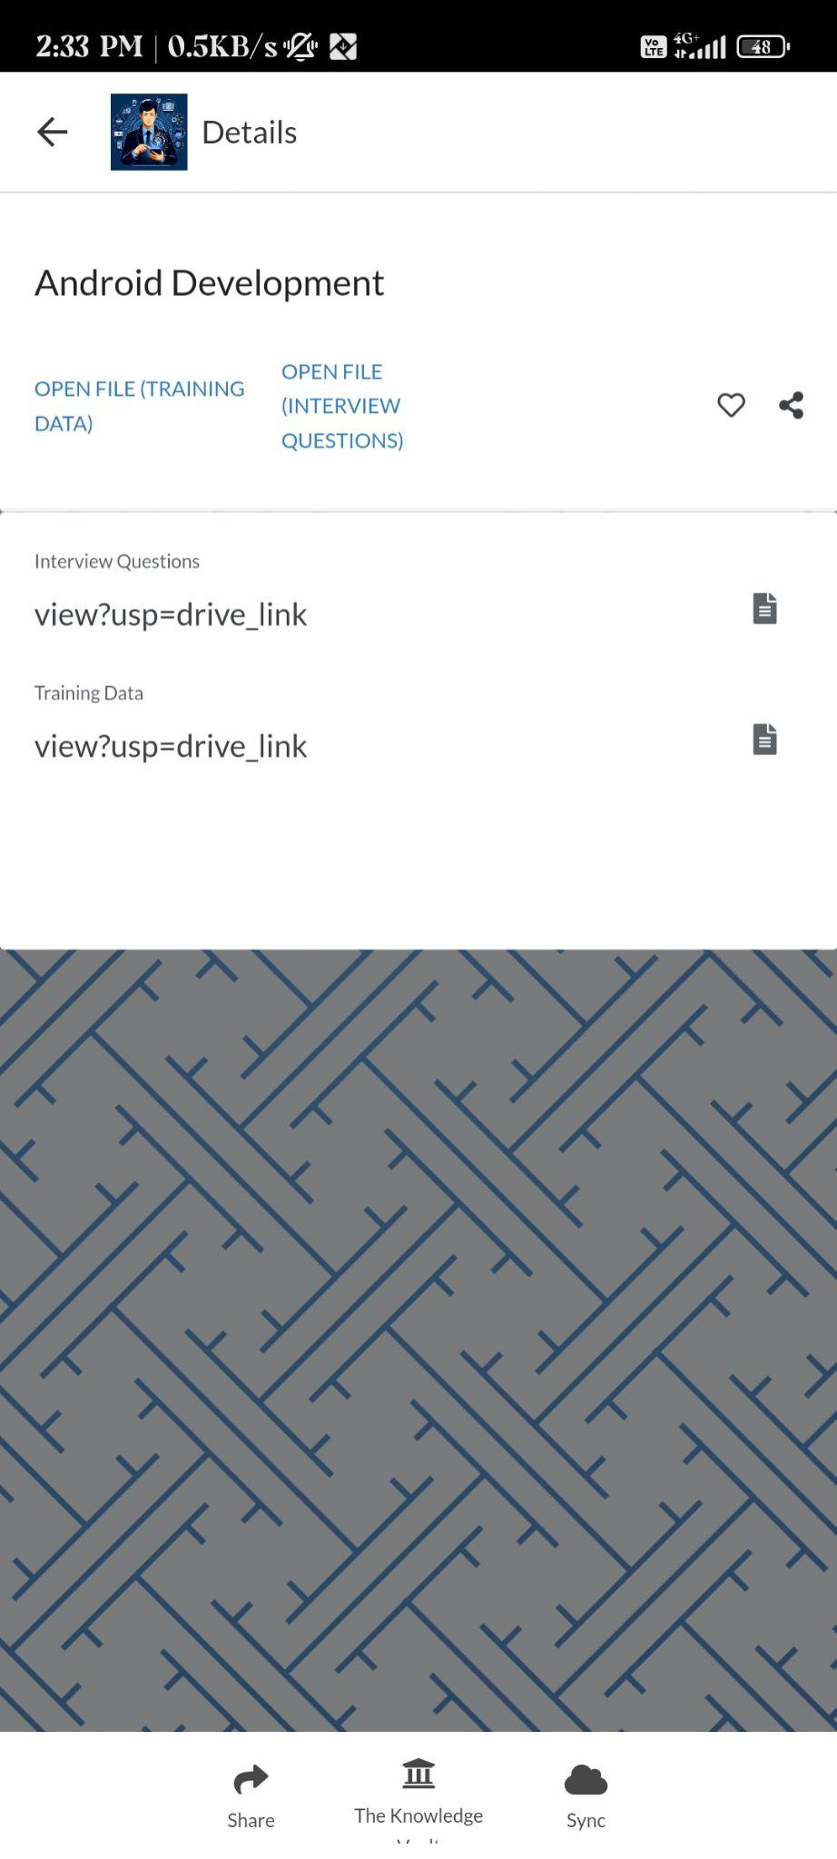
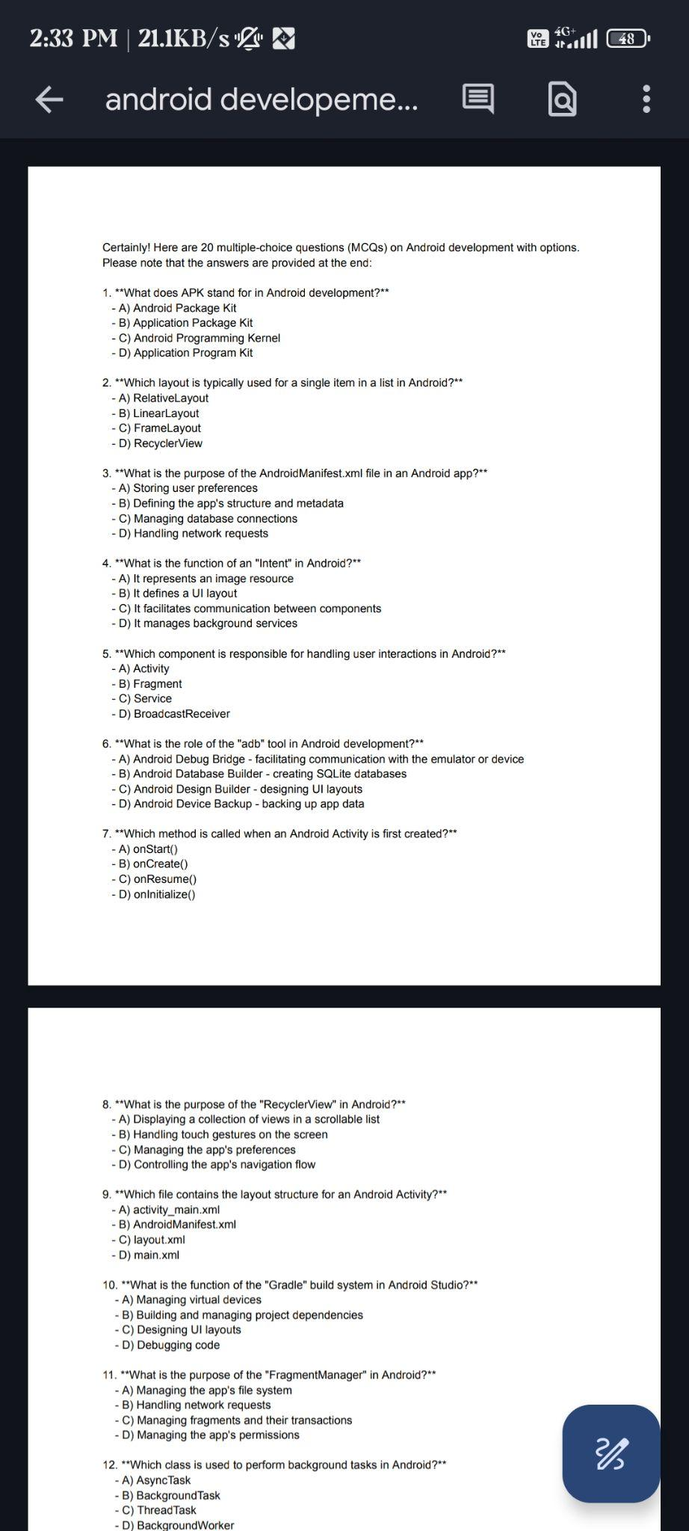
In training data there are interview question which helps in acing and cracking the interview.

Slide 11
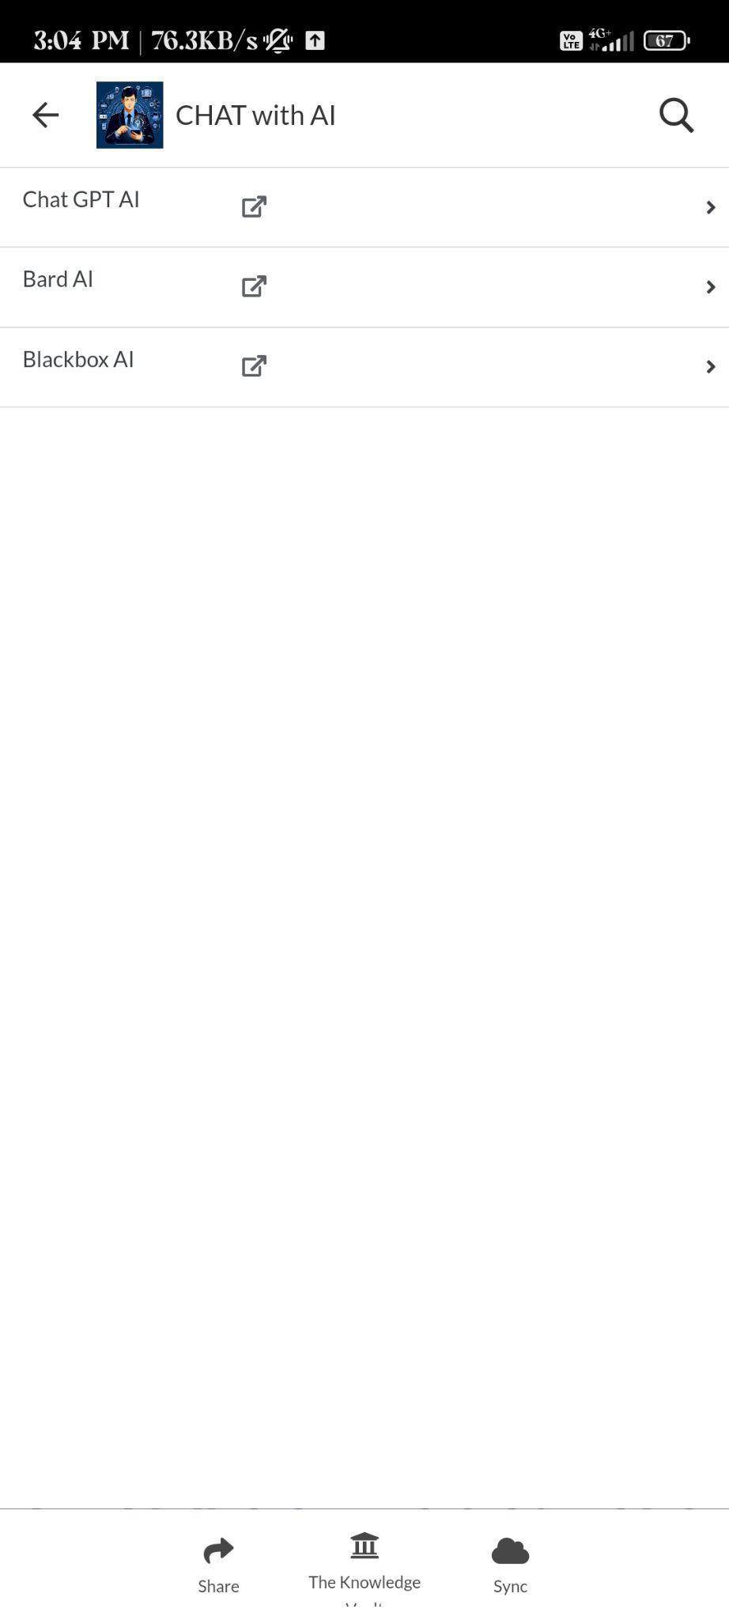
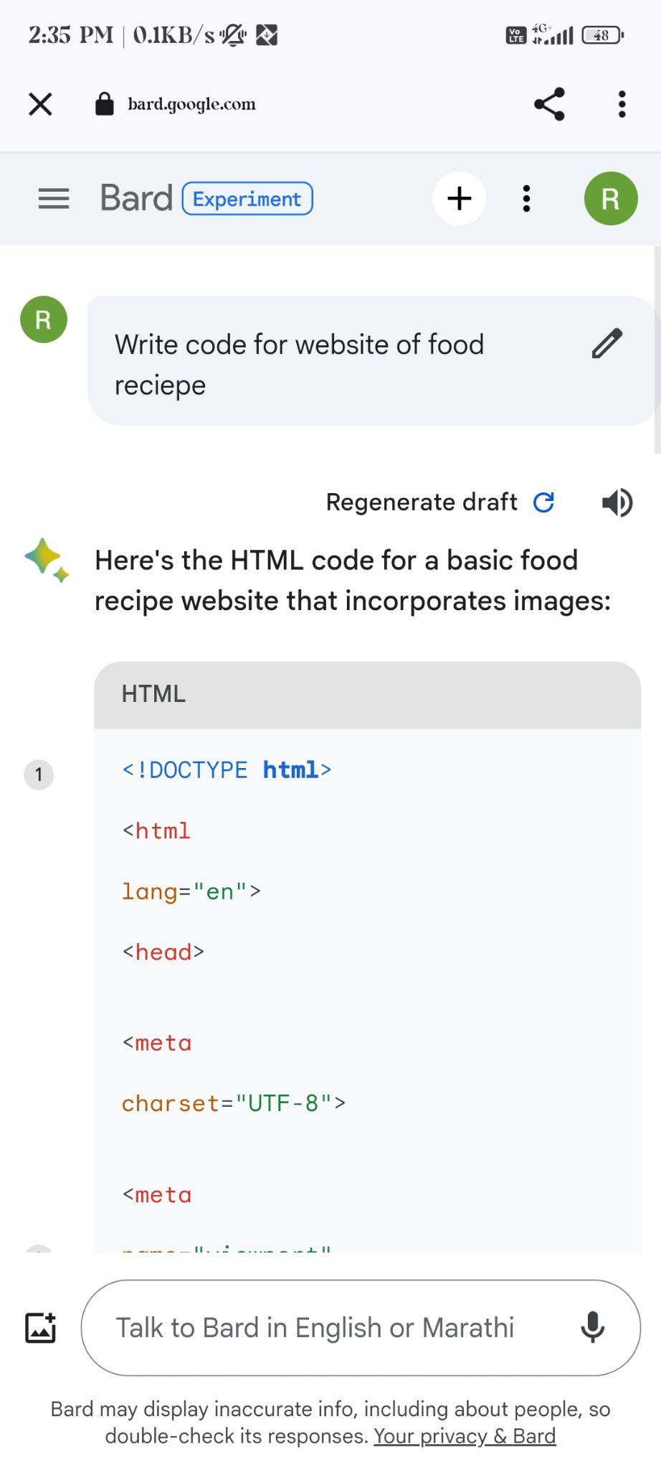
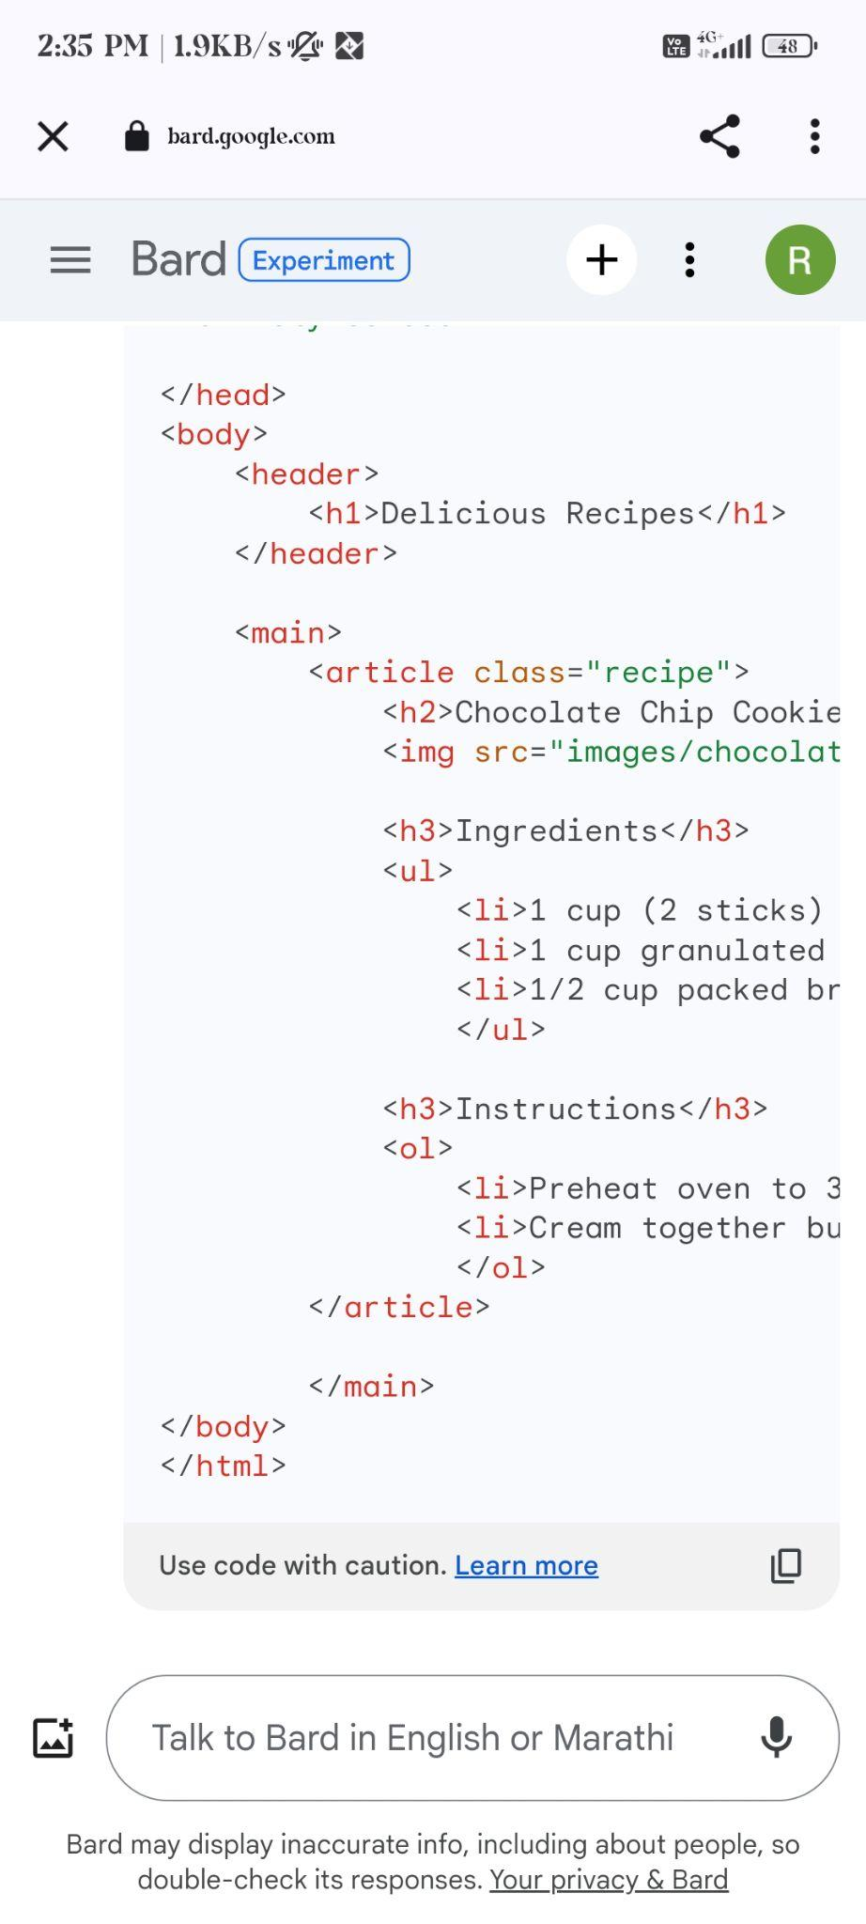
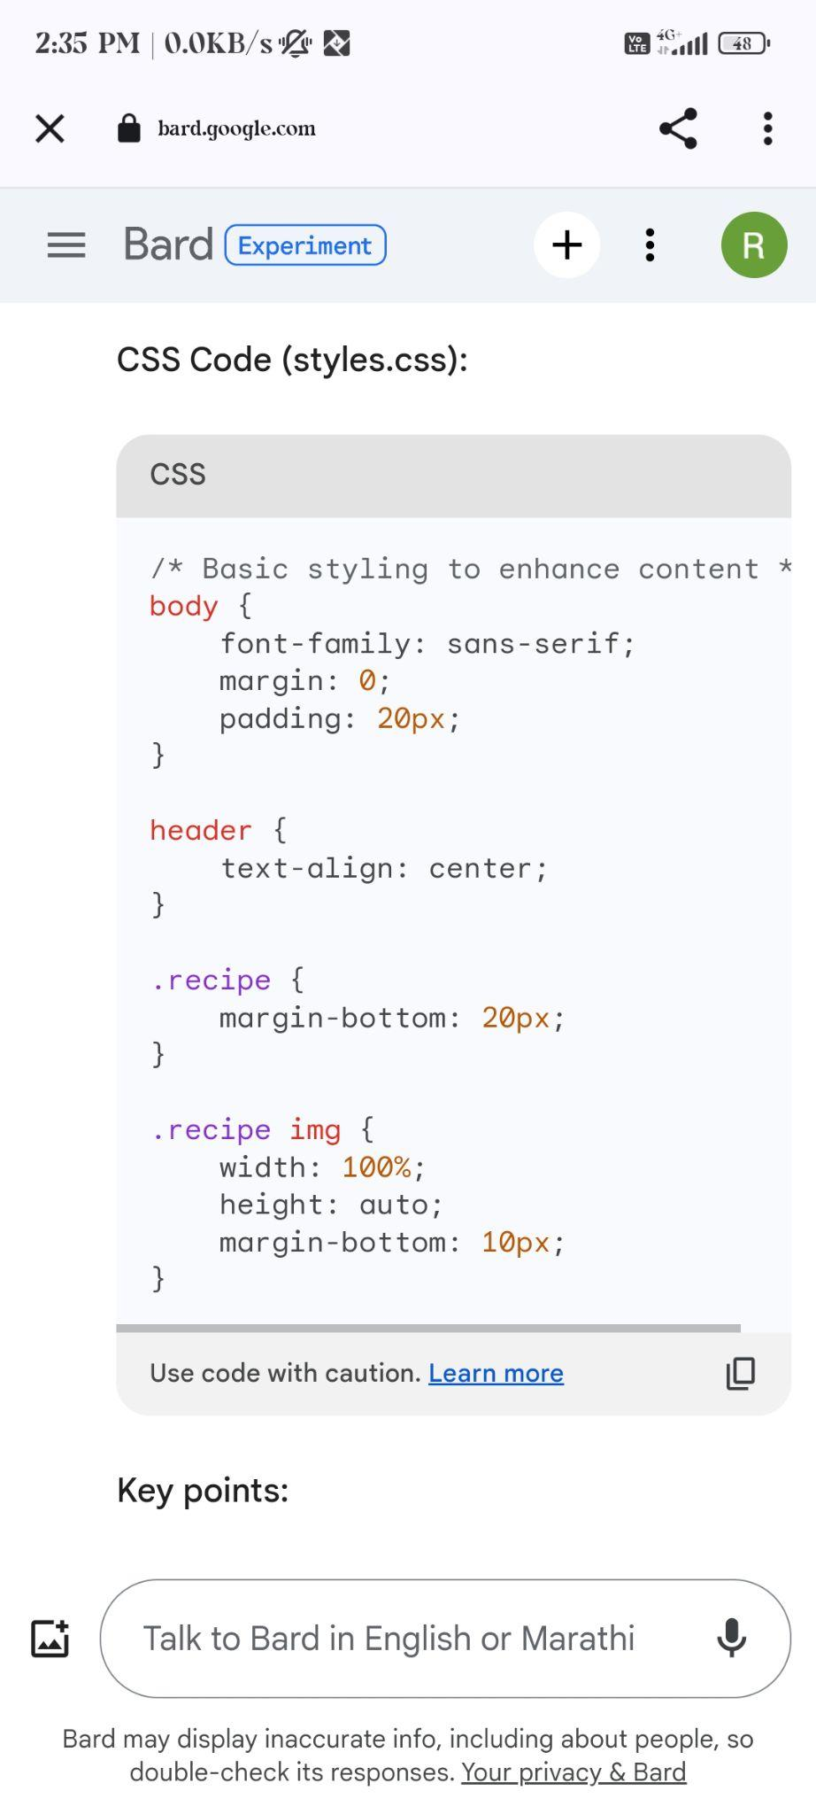
In chat Ai there are 3 AI tools 1.Chat gpt 2.Bard AI 3. Blackbox AI which helps to resolving the doubts and prepare for everything by asking them question.

Slide 12
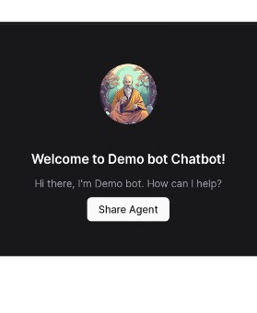
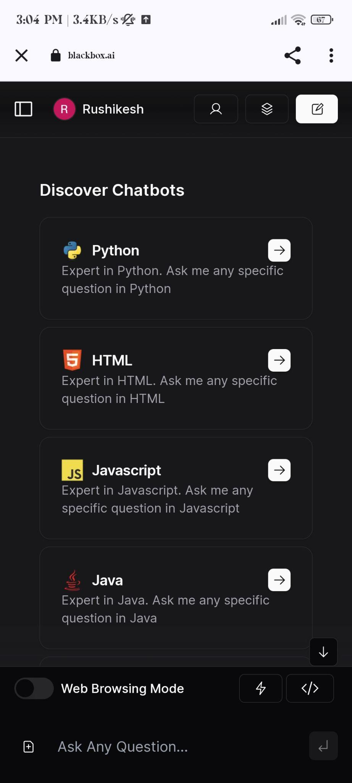
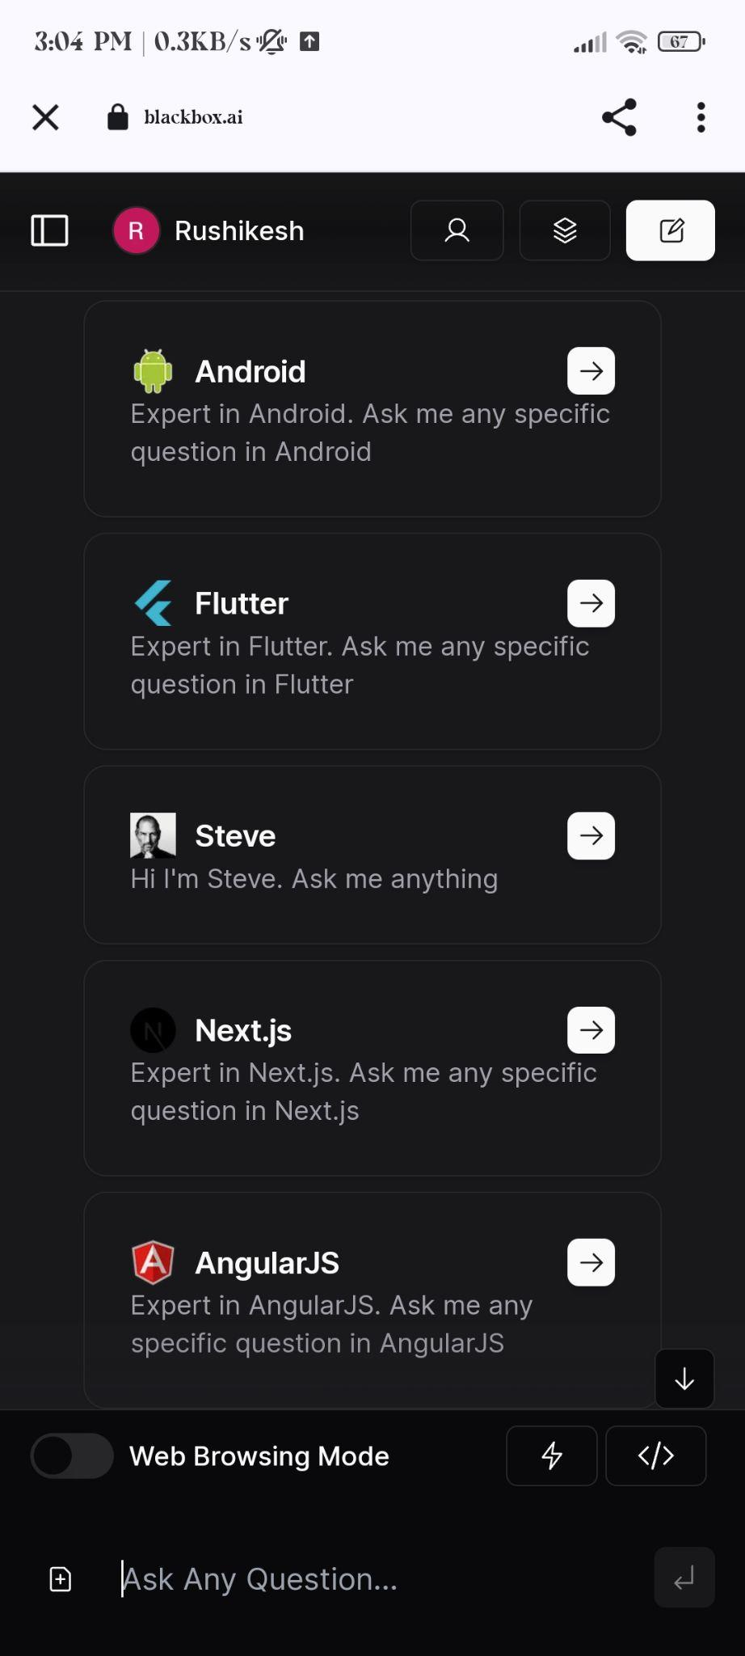
This is an customise chatbot made by an user in Blackbox AI

Slide 13
Justification for Our Choice
Creating app to aid coding beginners' challenges
Empathy driven education
Accessible learning for all
We aim to make coding education accessible and friendly for all.
Make coding education inclusive and welcoming for all
Breaking barriers
Supporting aspiring coders
Empower beginners on a guided coding journey.
App fosters coding confidence in a supportive environment.
Boosting confidence

Slide 14
SUCCESS & COMPLETION OF SOLUTION
THIS APP WIL TACKLE THE SDG 4 (QUALITY EDUCATION ) BY : DETAILED NOTES , SEQUENCIALISED VIDEO FOR LEARNING FROM SCRATCH, BASIC TO ADVANCED LEVEL UNDERSTANDING .
IT WILL CONSIST OF AI TOOLS LIKE : CHATGPT , BARD AI ( GOOGLE ) AND BLACKBOX AI AND IT WLL MAKE HUGE DIFFERENCE AND PROGRESS IN THE WORLD.
STORAGE : STORING DATA IN CLOUD STORAGE.

Slide 15











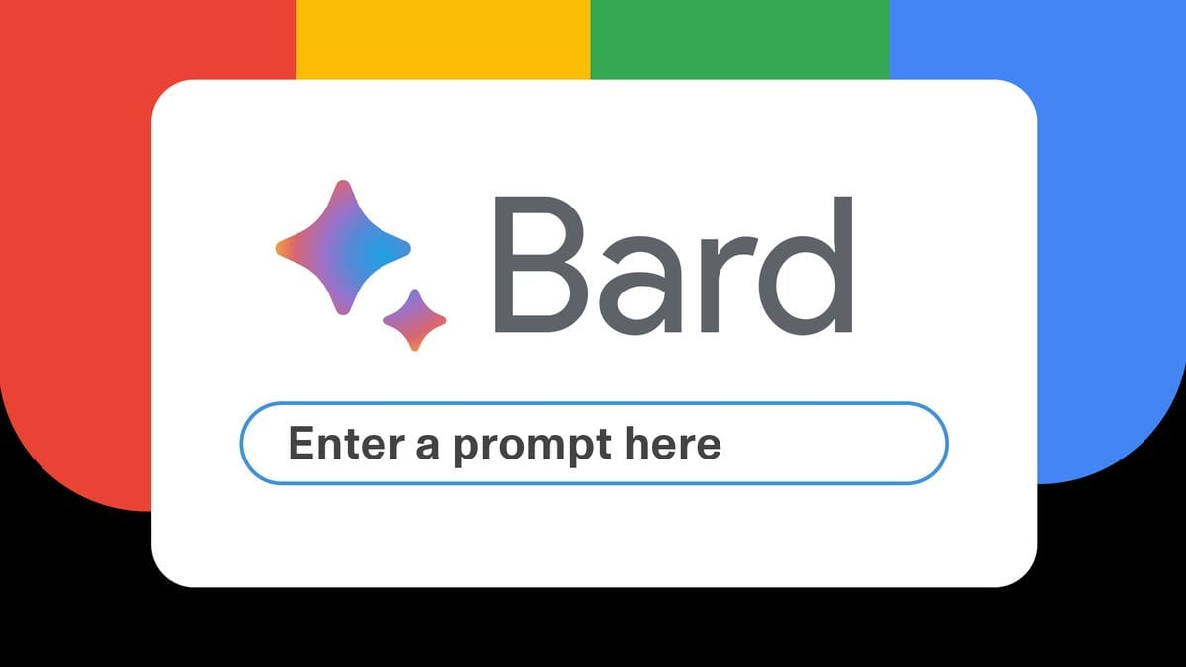


GOOGLE TECHNOLOGIES

Slide 16
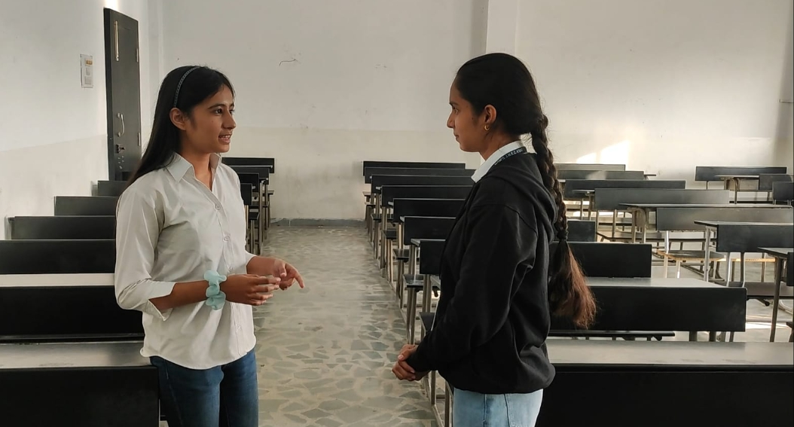
Feedback point and our improvement on that :
The knowledge vault
The knowledge vault
The knowledge vault
The knowledge vault
Confusion?
Where to start ?
Tired of paid courses?
AI Tools ?
Notes ?

Slide 17
FEEDBACK / TESTING / ITERATION
Resolved by
UI Designing
Using Google Appsheet
Storage
Using Multiple Google Drive Accounts
And cloud storage.

Slide 18
Impact on communities:-
CASE STUDY :
In essence, this solution pledges to confront the challenges associated with SDG 4 (Quality Education), actively advancing its objectives. By facilitating the acquisition of literacy among the youth through the delivery of quality data and learning opportunities, this application contributes significantly to the fulfillment of these goals.
Sequenced Learning: Structured
AI Tools : Personalized
Community Building: Collaborative
Empowerment: Self-efficiency
Global Reach: Inclusive

Slide 19

SCALABILITY
REACHING MORE : COLLABRATION WITH GOVERNMENT SCHEMES AND PARTNERSHIP .
INSPIRE THE NEXT GENERATION : GETTING FAMILIAR WITH AI
OPEN YOUR DATA : SHARING PROBLEMS AND SOLVING TOGETHER .
INTRODUCING MORE FEATURES : MORE AI TOOLS AND UPDATED EDUCATION TECHNOLOGY.
PRIVACY AND SECURITY : BETTER ACCESS CONTROL AND DATA SECURITY WITH SAFE SIGN IN.

Slide 20
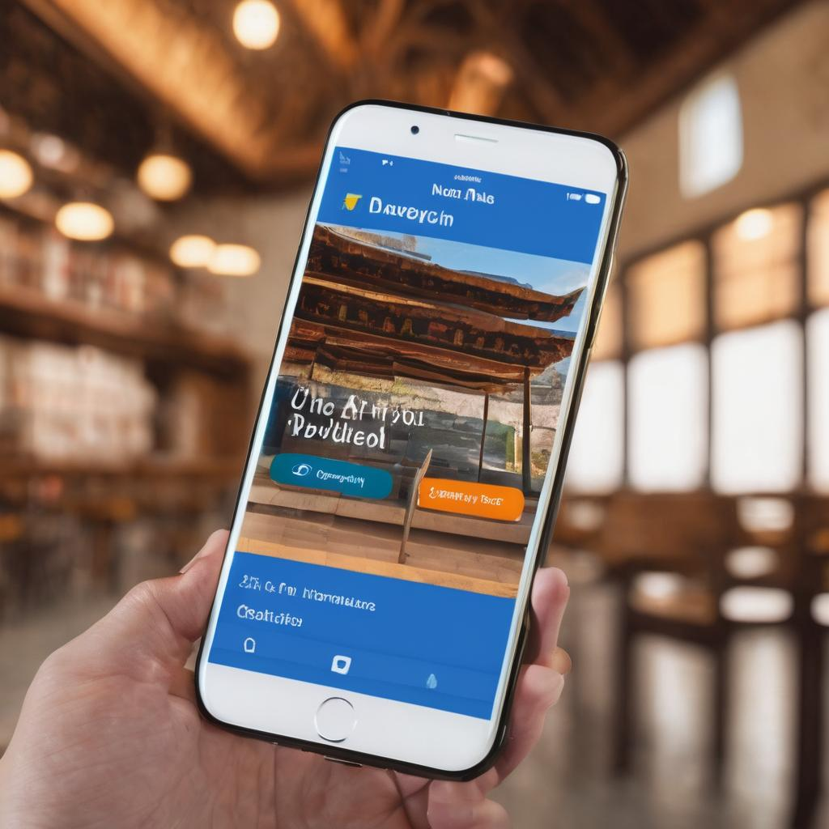
THANK
YOU

